Slide 1
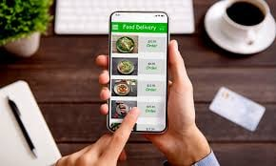
Advanced Object Oriented Programming CAN BOOK ANYTHING
By
Under the guidance of
Figlu Mohanty Mam
Roll Number | Name
2110030359 | B Chihnita Reddy
2110030320 | SIRISILLA Nikhitha Reddy
2110030284 | Shivani Konduri
2110030283 | N Rajashri

Slide 2
Can Book Anything
Our topic is Can Book Anything we had to choose to do the food ordering system.
An online food ordering system JAVA JSP MYSQL is a web-based application that stimulates the foodies (customers) to put food orders through the internet by locating their favorite restaurant or nearest one. This application is based on the HTML, CSS, JAVA, JSP (Java Server Page ), and MYSQL platform.
The online food ordering system JAVA JSP MYSQL provides convenience for the customers. It overcomes the disadvantages of the traditional queuing system. This system increases the takeaway of foods more than visitors.

Slide 3

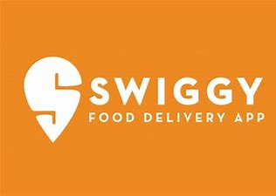
Existing Solutions
Existing algorithms are present for the food ordering system like Zomato and swiggy but they are having some drawbacks.
Drawbacks- Money transaction issues, Health concerns, delivery charges, expenses

Slide 4
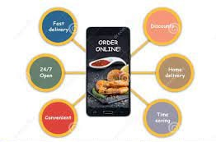
Proposed Algorithm
We are having some other best qualities like as
Quick Order Placement
Alerts and Push-notifications
Scalable & Flexible features
Real-time Delivery Tracking
Multiple payment modes
Dynamic Analytics
Instant feedback and chat for better consumer-experience
Personalized user interface
Customer Behaviour Analysis

Slide 5
Modules and their requirements
User Module :
Login
Registration
View Menu
Order
Order History
Feedback
Admin Module :
Login
View Menu
Add Menu Item
Delete Menu
View All User
View All Order
View All Feedbacks
View Specific User all Order

Slide 6
Software Requirements
Front end – JSP,HTML,CSS
Backend – MYSQL
Software:
IDE - NetBeans 8.2
Database support - MySQL 5.7
Server deployment - Glassfish server

Slide 7
Technology used
HTML- It provides a means to structure text-based information in a document
CSS- CSS(Cascading Style Sheets) is a style sheet language used for describing the presentation of a document written in a markup language.
JAVASCRIPT- JavaScript is a scripting language that supports the development of both client and server applications.
MYSQL- SQL is the language used to manipulate relational databases. It is tied closely with the relational model. It is issued for data definition and data manipulation.

Slide 8
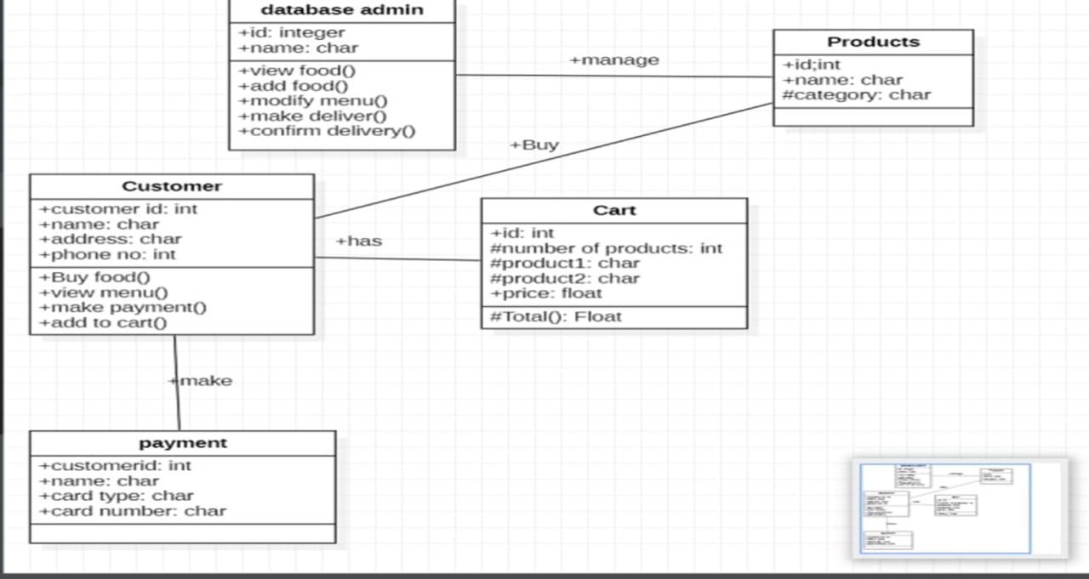
Class Diagram-

Slide 9


